Slide 1
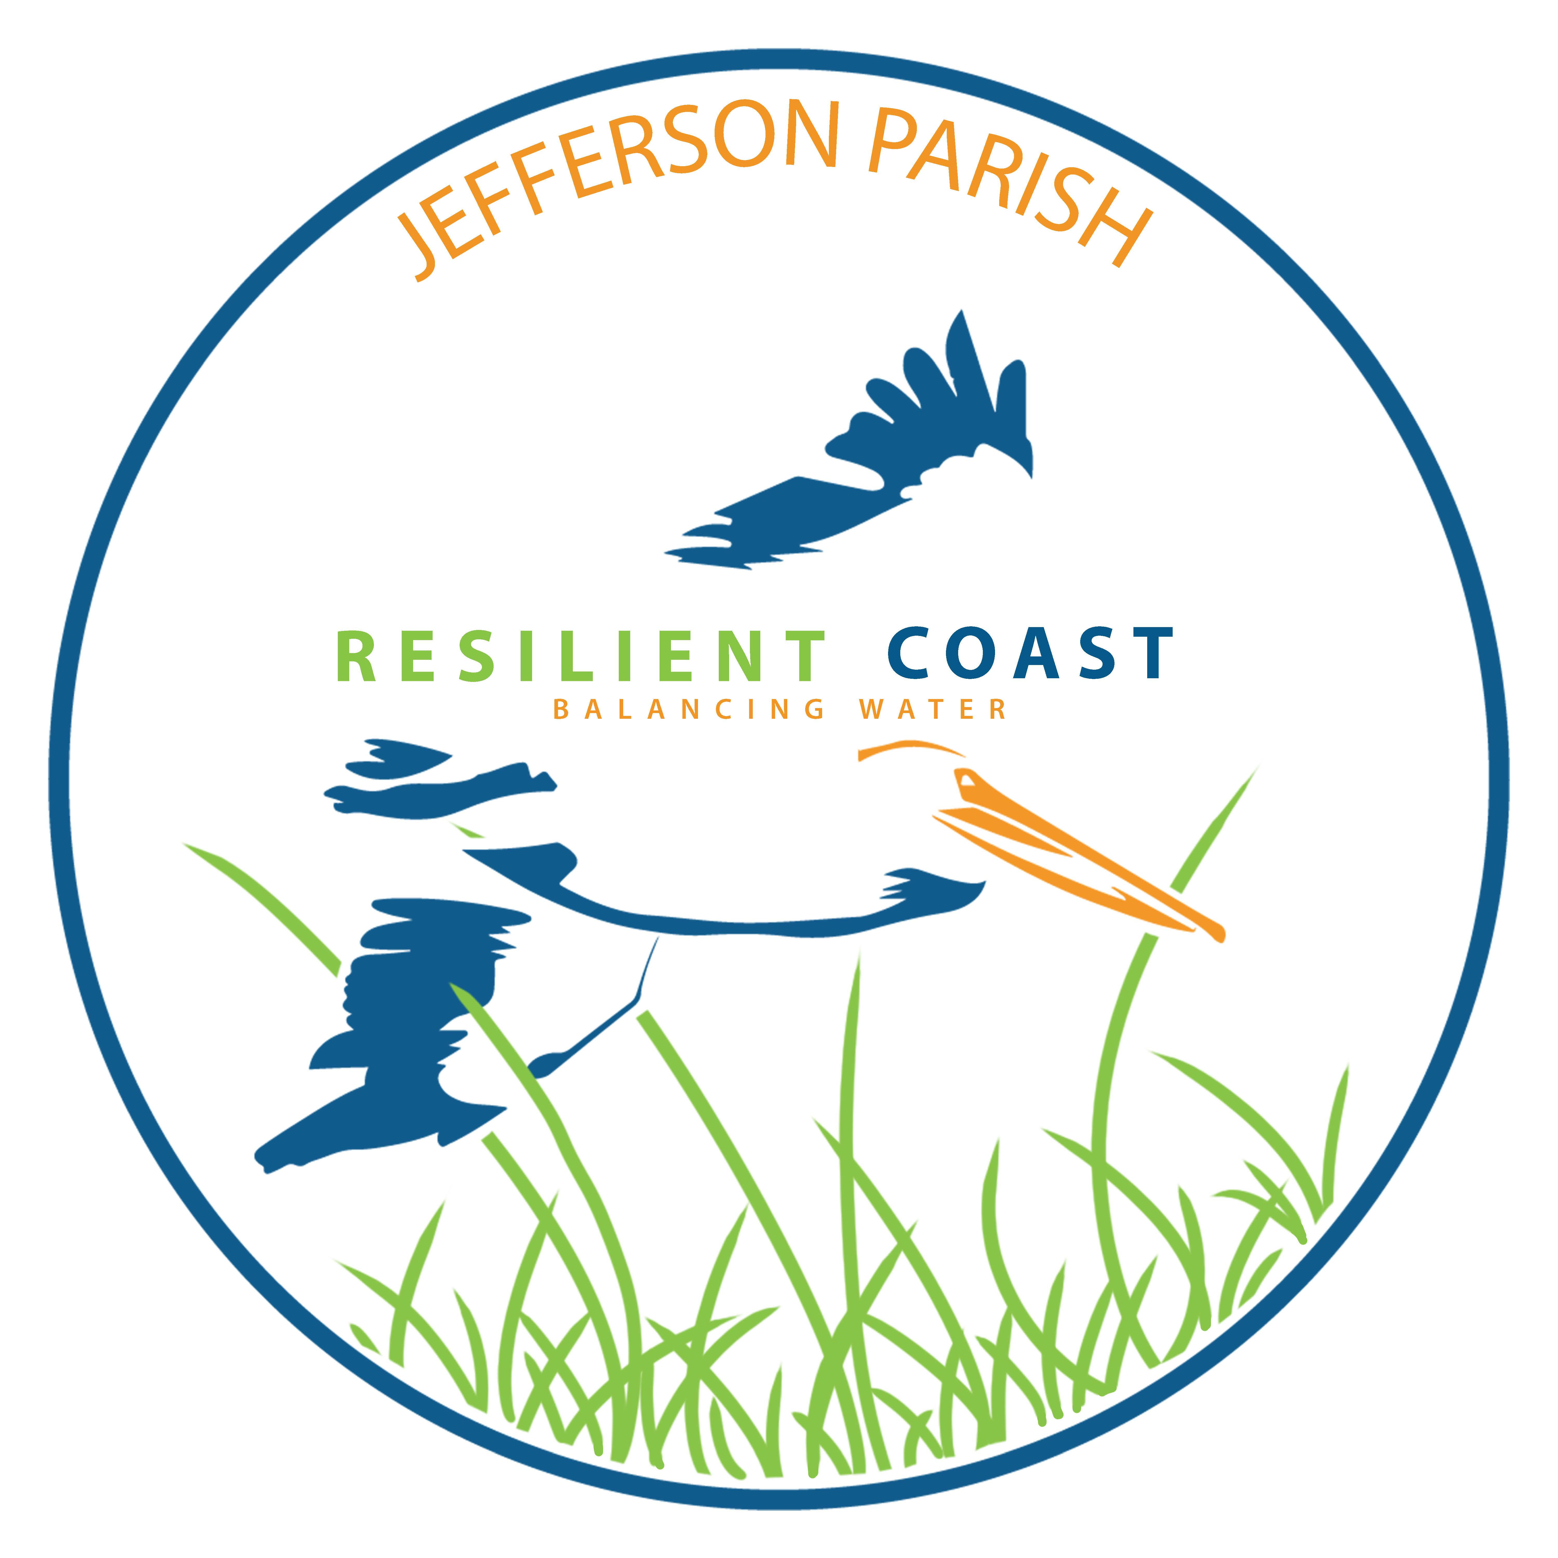
2018 Jefferson Parish Coastal Management Update

Slide 2
Parish Coastal ManagemeMission
To build and manage a resilient and sustainable coastal community by stewarding restoration projects with state and federal agencies;
Educate our parish on coastal issues through outreach and community education events;
Coastal Use Permit management of construction, development, and production activities in our coastal zone.

Slide 3
Coastal Priorities
Develop a revised Coastal Comprehensive Plan that Prioritizes and Schedules Projects based on funding opportunities
Maximize Grant and Match Funding Opportunities
Develop an Outreach and Education program to work with our schools, stakeholders, legislators, the business community.

Slide 4
Jefferson Coastal Projects
RESTORE Multi-year Implementation Plan
Grand Isle Bayside Segmented Breakwaters
Mississippi River Long Distance Sediment Pipeline – Phase 2
BUDMAT Program – Barataria Waterway Project
Mid Barataria Marsh & Ridge Restoration Program – WRDA 2018 Report
Bucktown Harbor & Wetland Restoration

Slide 5
RESTORE Multi-Year Implementation Plan: Grand Isle Bayside Segmented Breakwater Project

Slide 6
Phase 2 – Mississippi River Long Distance Sediment Pipeline

Slide 7
Mid Barataria Marsh & Ridge Restoration Program

Slide 8
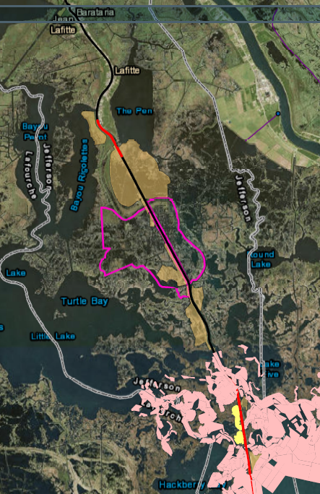
Lousiana Coastal Area (LCA) Beneficial Use of Dredged Material (BUDMAT) - Barataria Waterway Project
75/25 Cost Share between the Corps
Jefferson Parish
$1.47M Design Cost
Slated for Dredging Cycle Fall 2019

Slide 9
Bucktown Marina Wetland Boardwalk

Slide 10
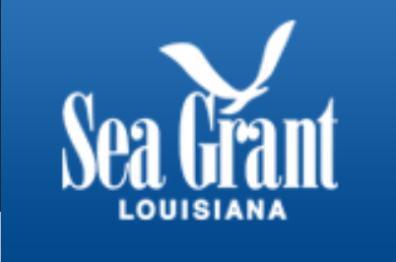
Bucktown Harbor Vision Plan & Wetland Project

Slide 11
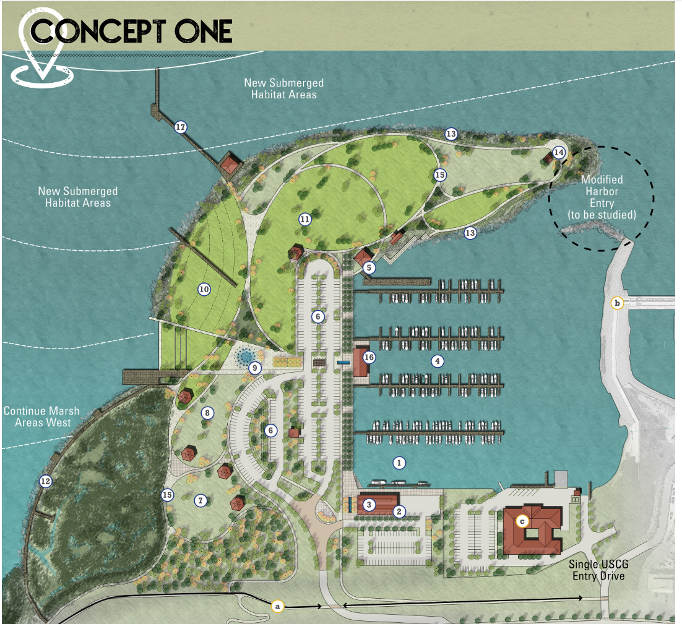
Bucktown Harbor Vision Plan - May 2018

Slide 12
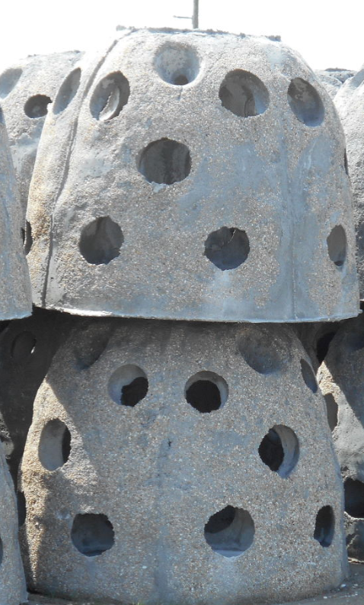
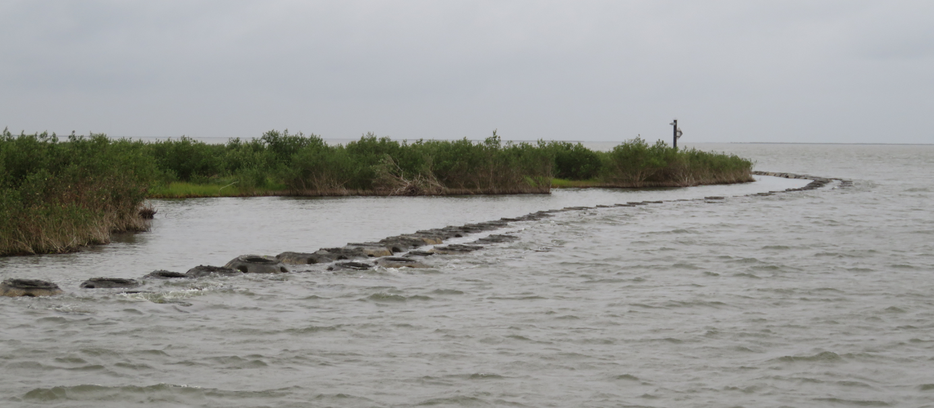
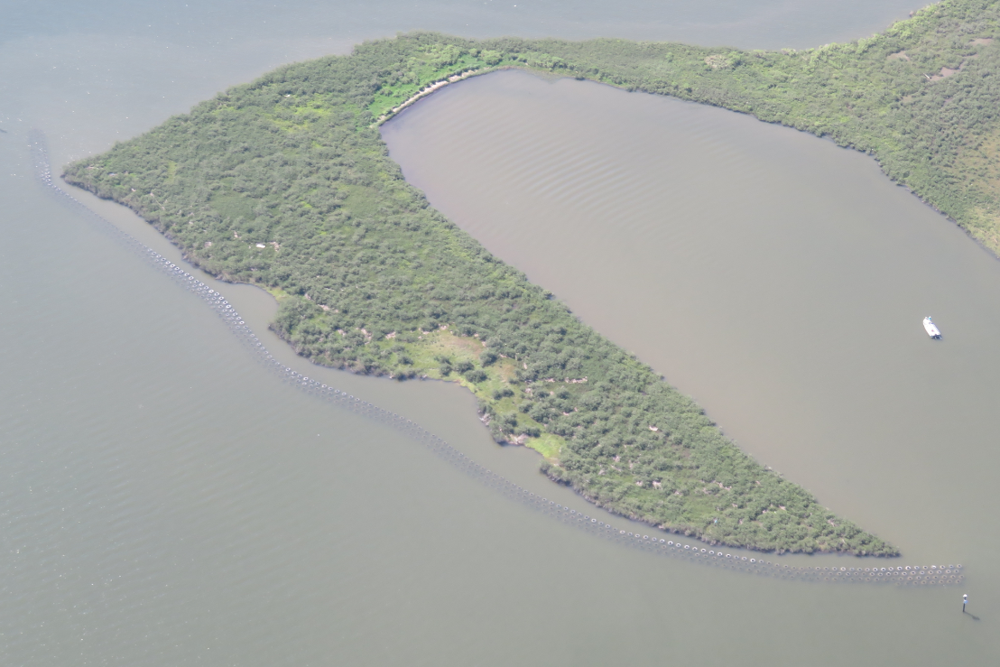
Grand Isle Reef Ball Living Shoreline
Notes:
Purpose: 1. Attenuate wave energy reaching the shore.
2. Stimulate oyster growth to increase biodiversity of immediate area.
Project site: 1. Located on the coastal fringe marsh in Jefferson Parish on the north side of Chenier Caminada. The project is characterized by low marsh with an erosional shoreline.
Solution Requirements: 1. Project solutions must reduce wave energy, be stable on the soil, remain in place during storm events, and provide a platform for oysters to grow on.
2. The project design criteria is a 10-year design life and to remain stable for a 10 year storm, or approximately a Category 1 Hurricane at this site.

Slide 13
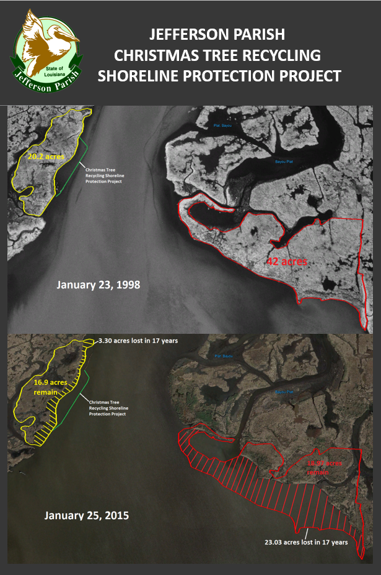
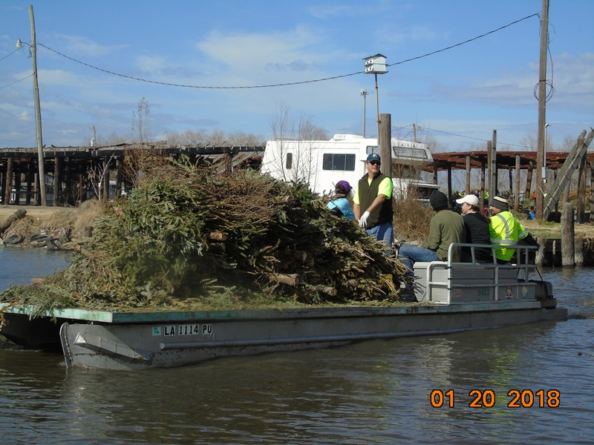
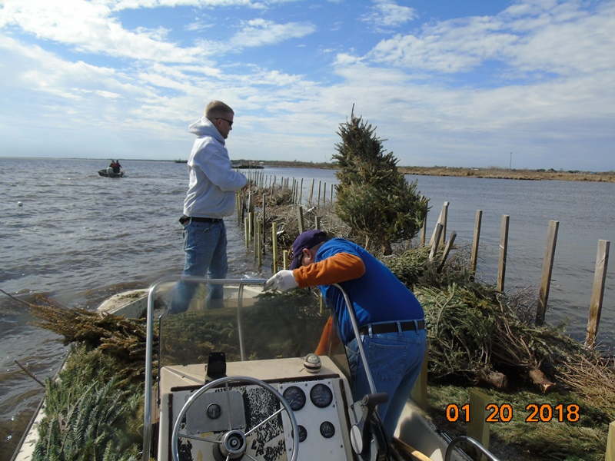
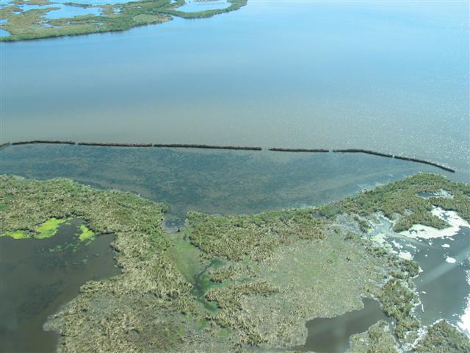
Post project SAV growth
Notes:
Project Quick Facts:
1. Since 1991, over 800,000 Christmas trees, or over 900 linear miles worth, have been recycled by using them to mitigate shoreline erosion and rebuild wetlands, rather than taking up valuable landfill space.
2. Approximately 5,000 trees are collected annually and are used to build tree fences that slow wave action, trap sediments, combat erosion, and protect wetlands

Slide 14
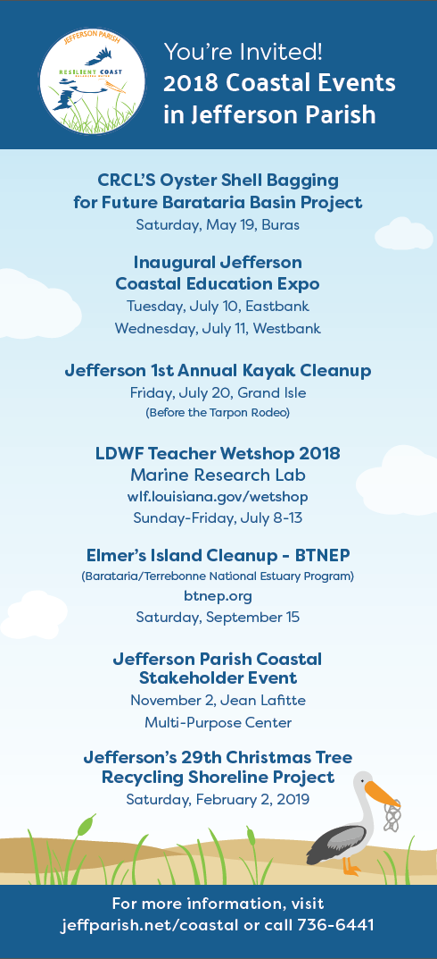
Added: Fall of 2018 -Oyster Recyling Partnership with CRCL and Jefferson Parish District 5 Oyster Fest

